Slide 1

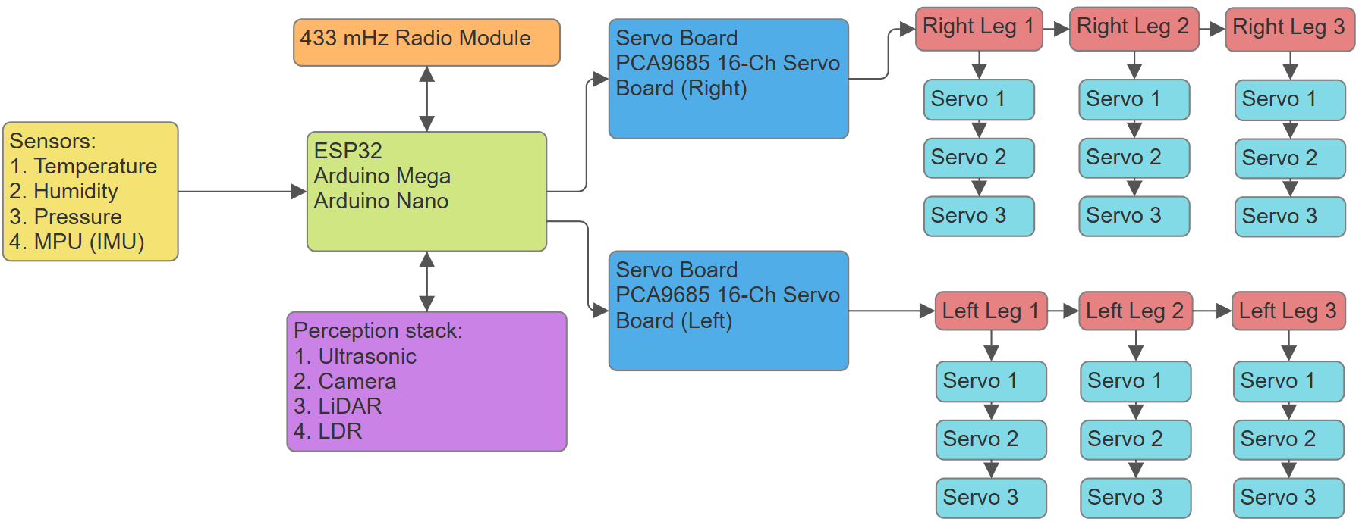
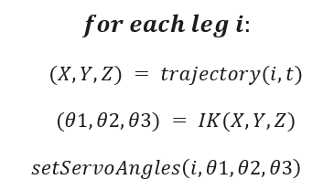
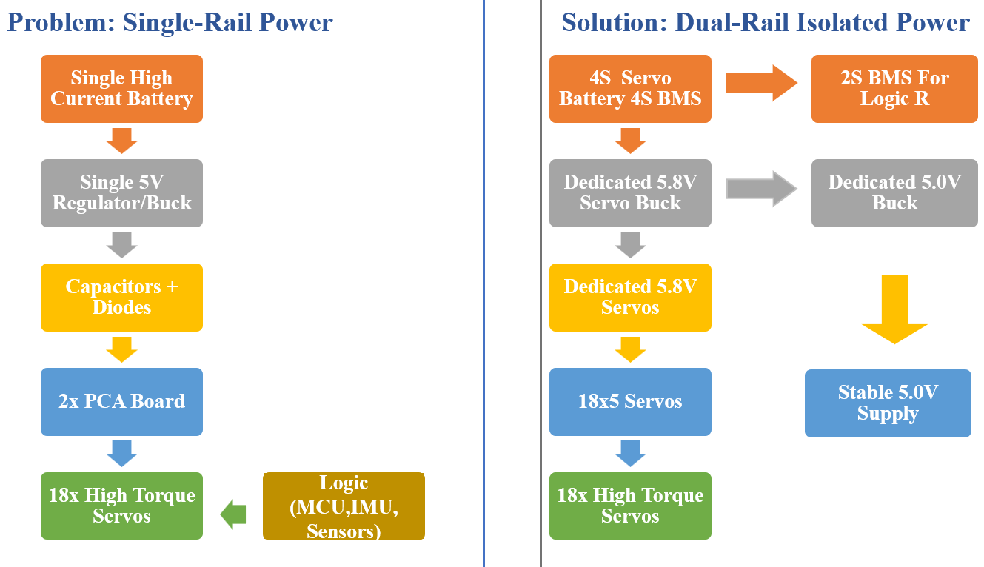
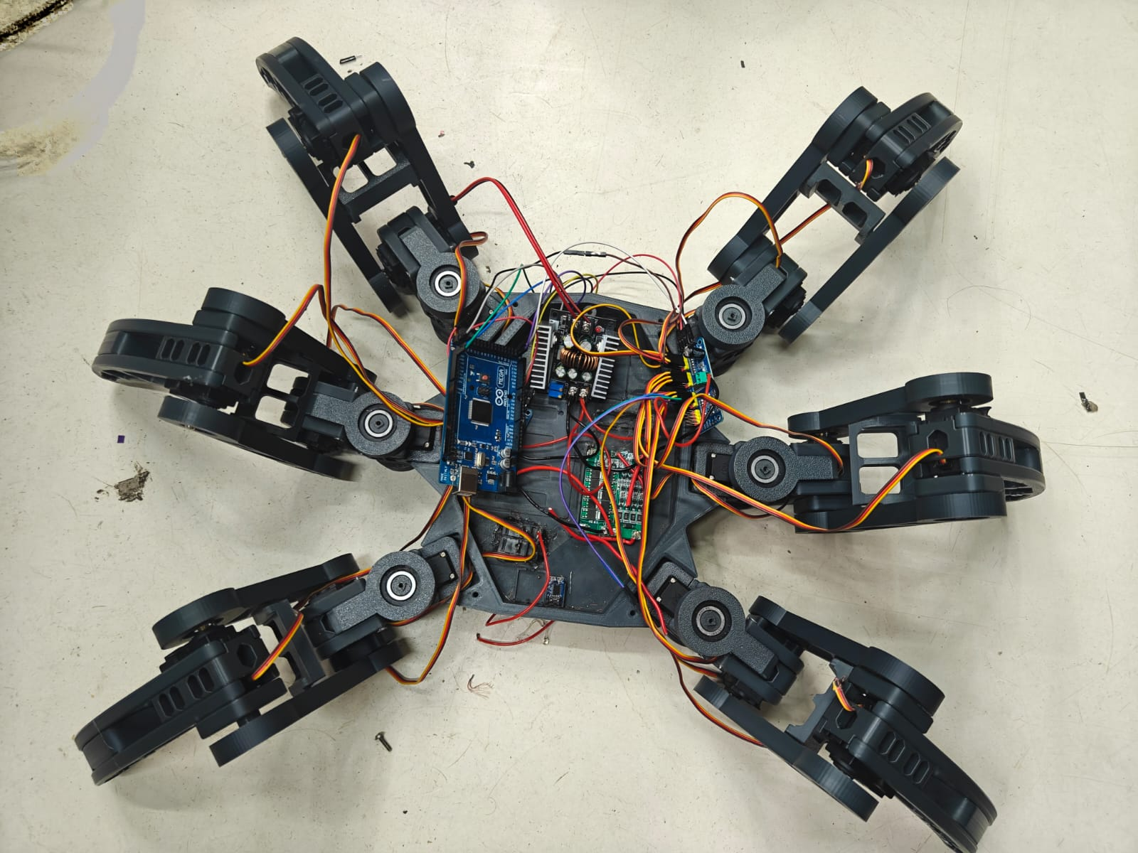
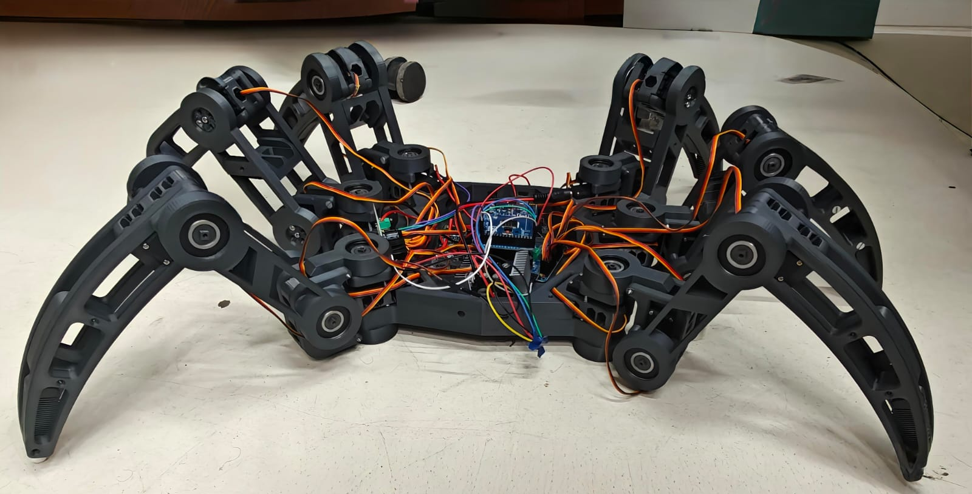
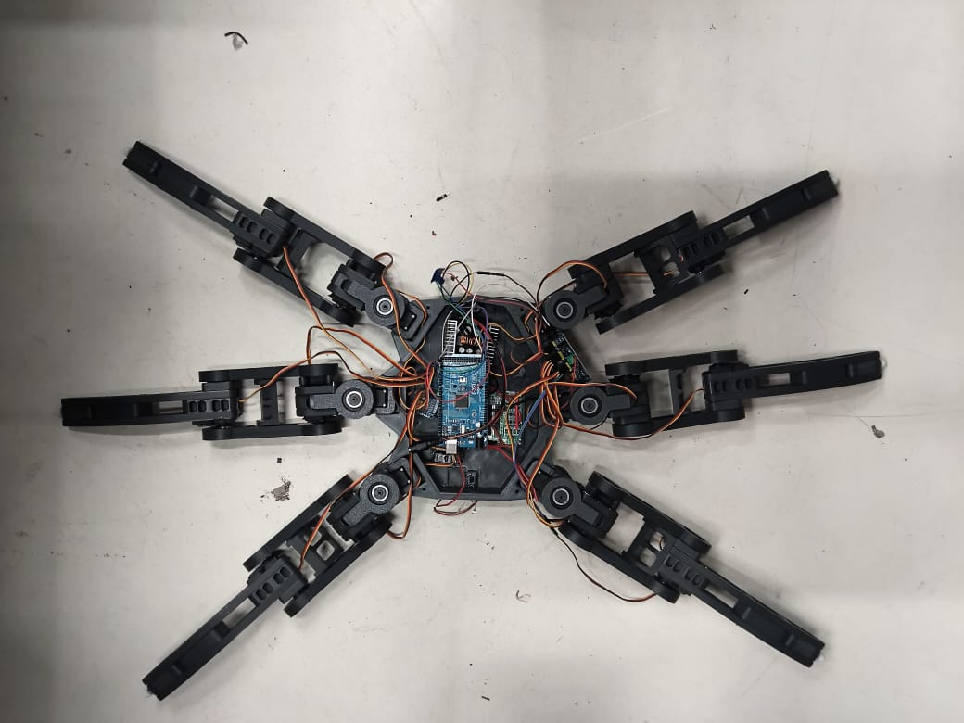
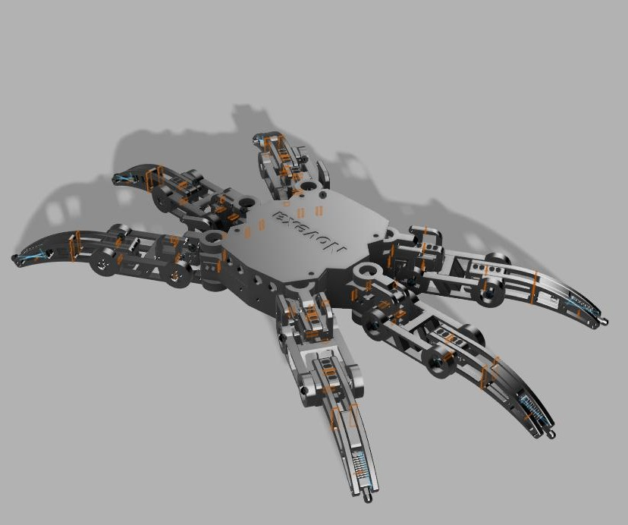





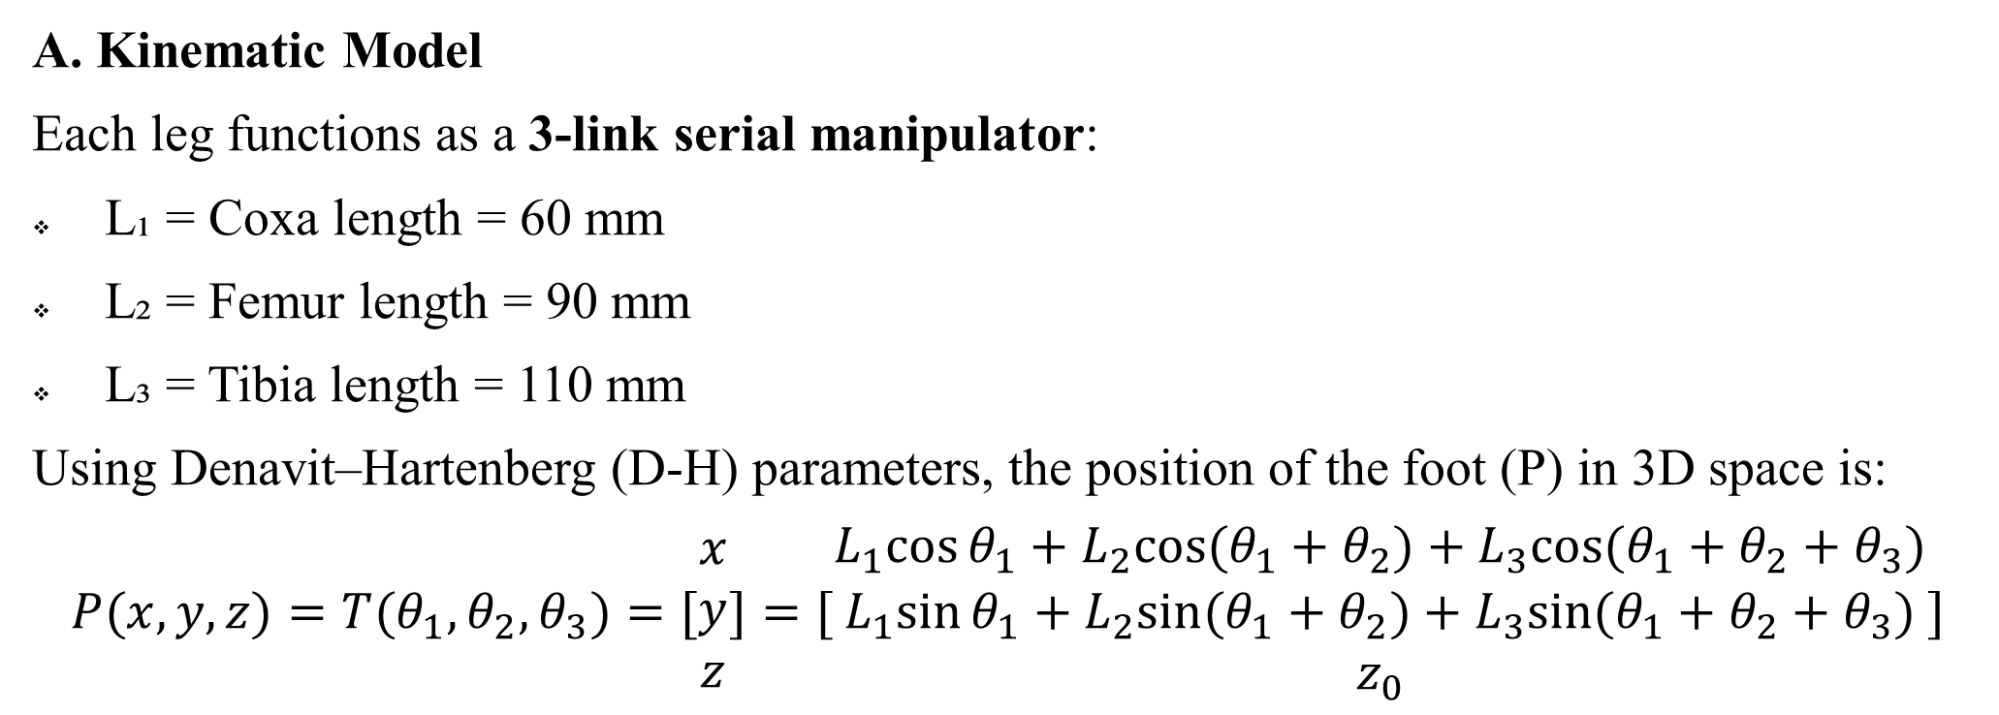
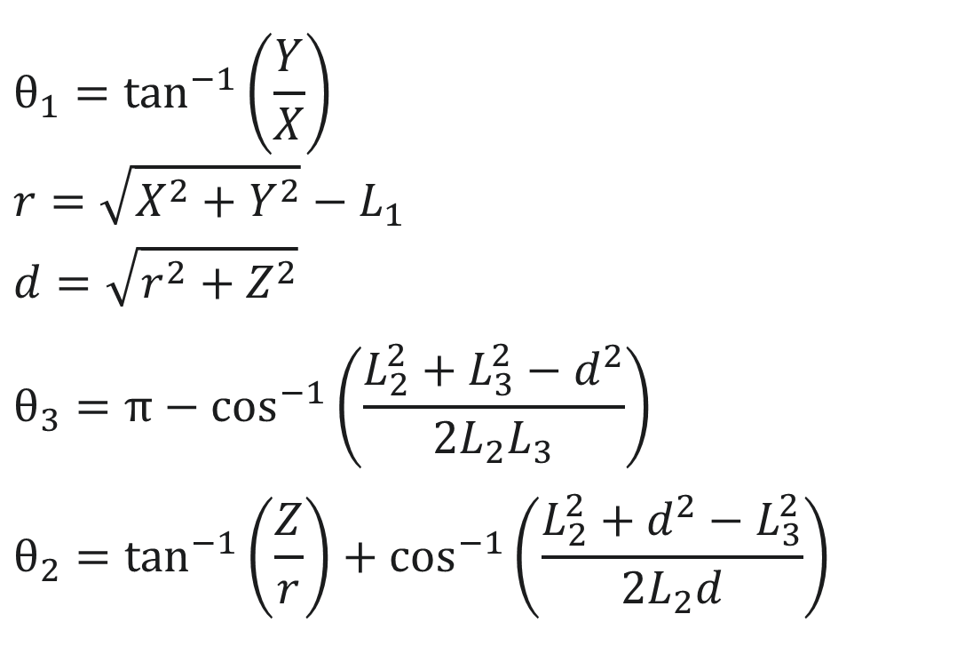
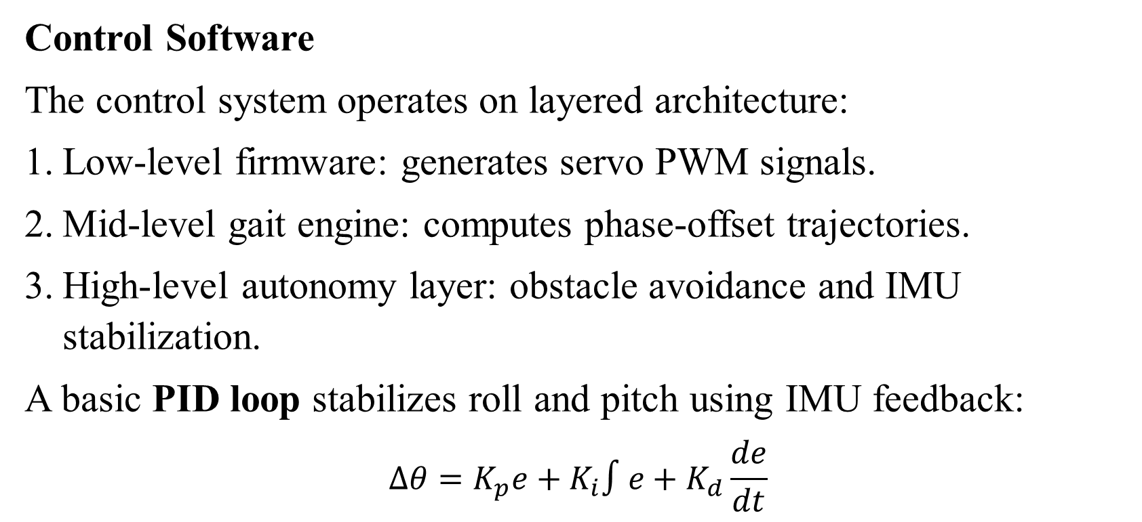
Design and Development of a 3D-Printed Hexapod Robot for Terrain-Adaptive Locomotion and Autonomous Navigation
Aditya Jadav, Archie Veera, Bilal Sabugar, Rabinder Henry
Introduction
Kinematics and Gait Design
The design, development, and control of a 1-meter class 3D-printed hexapod robot developed as an experimental platform for terrain-adaptive locomotion and autonomous navigation. The system features six articulated legs, each providing three degrees of freedom (DOF), yielding a total of 18-DOF mobility.
The robot structure was designed using additive manufacturing (3D printing) for modularity and cost-efficiency. A microcontroller-based gait engine implemented on an ESP32, Arduino Mega and Arduino Nano coordinates servo actuation for tripod, ripple, and wave gaits. Embedded sensors, including an IMU (MPU6050) and ultrasonic rangefinders, provide feedback for orientation stabilization and obstacle avoidance.
The project demonstrates the feasibility of lightweight polymer-based robotic designs for educational and research applications in locomotion control, biomechanics, and terrain robotics. The results validate that 3D-printed hexapods can achieve stable and energy-efficient walking patterns comparable to traditional machined platforms at significantly reduced cost and weight. The block diagram of the autonomous systems is shown in Figure 1.
A. Kinematic Model
Each leg functions as a 3-link serial manipulator:
L₁ = Coxa length = 60 mm
L₂ = Femur length = 90 mm
L₃ = Tibia length = 110 mm
Using Denavit–Hartenberg (D-H) parameters, the position of the foot (P) in 3D space is:
$$P(x,y,z)=T(θ_{1},θ_{2},θ_{3})=[\begin{aligned}x \\ y \\ z\end{aligned}]=[\begin{aligned}L_{1}cos⁡θ_{1}+L_{2}cos⁡(θ_{1}+θ_{2})+L_{3}cos⁡(θ_{1}+θ_{2}+θ_{3}) \\ L_{1}sin⁡θ_{1}+L_{2}sin⁡(θ_{1}+θ_{2})+L_{3}sin⁡(θ_{1}+θ_{2}+θ_{3}) \\ z_{0}\end{aligned}]$$
B. Gait Planning
Three primary gaits were implemented:
Tripod Gait: 3 legs move while 3 support the body (fast and efficient).
Ripple Gait: Sequential leg motion (smooth, stable on rough terrain).
Wave Gait: One leg at a time (high stability, low speed).
Each gait cycle is time-synchronized using sinusoidal position functions:
$$θ_{1}=\tan^{−1}\left(\frac{Y}{X}\right) \\ r=\sqrt{X^{2}+Y^{2}}−L_{1} \\ d=\sqrt{r^{2}+Z^{2}} \\ θ_{3}=π−\cos^{−1}\left(\frac{L_{2}^{2}+L_{3}^{2}−d^{2}}{2L_{2}L_{3}}\right) \\ θ_{2}=\tan^{−1}\left(\frac{Z}{r}\right)+\cos^{−1}\left(\frac{L_{2}^{2}+d^{2}−L_{3}^{2}}{2L_{2}d}\right)$$
$$θ_{i}(t)=A_{i}sin⁡(ωt+φ_{i})$$
Figure 1. Hexapod- Block Diagram
System Overview
Conception
Control System
Parameter | Specification
Footprint (L × W × H) | 45 cm × 69 cm × 27 cm
Total Mass | 5.5–6.0 kg
Material | PLA (3D-printed)
Degrees of Freedom | 18 (3 per leg × 6 legs)
Power Supply | 7.4–12 V DC
Control Board | ESP32 (dual-core, Wi-Fi enabled)
Motion Drivers | PCA9685 16-channel PWM boards
Sensors | MPU6050 (IMU), Ultrasonic (×3), optional camera
Runtime (typical) | 45–60 minutes per charge
Build Envelope | ≤ 1000 mm footprint, ≤ 400 mm height
The conception of NOVEXA was driven by a specific engineering challenge: solving the critical power instability seen in many 18-servo hexapod builds. While the 3-DOF mechanics were well-established by the open-source community, the goal is to re-engineer the platform from the ground up, focusing on a clean, integrated design with dedicated spaces for all components, and, most critically, solving the power problem.
The core concept was to engineer a robust, dual-rail power architecture from the outset, completely isolating the high-current 4S servo supply from the sensitive 2S logic rail. This would create a reliable and fault-tolerant foundation. To validate the mechanical feasibility and component fit of this integrated design, a 1:1 scale cardboard model was first used to verify all physical dimensions and clearances.
Control Software
The control system operates on layered architecture:
Low-level firmware: generates servo PWM signals.
Mid-level gait engine: computes phase-offset trajectories.
High-level autonomy layer: obstacle avoidance and IMU stabilization.
A basic PID loop stabilizes roll and pitch using IMU feedback:
$$Δθ=K_{p}e+K_{i}∫e+K_{d}\frac{de}{dt}$$
Prototpye
Structural Configuration
The hexapod’s chassis consists of a central hub, two side plates, and six articulated legs symmetrically positioned at 60° intervals. Each leg has:
Coxa joint: horizontal rotation (yaw)
Femur joint: vertical lift (pitch)
Tibia joint: forward extension (pitch)
This configuration offers a large working envelope while maintaining a low center of gravity.
Summary & Future Perspective
NOVEXA is a 3-DOF, 3D-printed hexapod robot.Its key innovation is a dual-rail power system (4S servo pack, 2S logic pack) that eliminates processor brown-outs caused by servo current spikes. This creates a highly reliable platform, validated for complex kinematics with a 20-minute runtime.
Future Perspective:
Autonomous Navigation: Integrating ROS2 (Robot Operating System 2) for advanced autonomous terrain mapping and navigation.
Intelligent Gaits: Implementing neural gait optimization using TinyML on a new microcontroller, allowing the robot to learn and adapt its walk to different surfaces in real-time.
Actuator Upgrade: Upgrading all 18 joints from analog servos to high-performance metal-gear brushless servos to increase torque, speed, and durability.
Sensor Integration: Developing a modular sensor pod (e.g., with Lidar, camera, and environmental sensors) for comprehensive environmental mapping.
Endurance: Adding solar-assisted charging panels to the robot's chassis to extend operational runtime for long-duration outdoor missions.
Researchers
aditya.jadav.btech2025@atlasskilltech.university
archie.veera.btech2025@atlasskilltech.university
Aditya Jadav
Archie Veera
bilal.sabugar.btech2025@atlasskilltech.university
rabinder.henry@attlasuniversity.edu.in
Bilal Sabugar
Prof..Dr Rabinder Henry
References
[1] Hirose, S. (1993). Biologically Inspired Robots: Snake-like Locomotors and Manipulators. Oxford University Press.
[2] Kimura, H. et al. (2018). Adaptive Dynamic Walking of Multi-Legged Robots. Robotics and Autonomous Systems.
[3] Siciliano, B., & Khatib, O. (2016). Springer Handbook of Robotics. Springer.
[4] Gupta, S. et al. (2023). Design and Additive Manufacturing of Modular Hexapods for Education. IEEE EDUCON Proceedings.
[5] Nolfi, S., & Floreano, D. (2000). Evolutionary Robotics. MIT Press.

